Slide 1
Online Multi-Target Tracking Using Recurrent Neural Networks
Supervisor: Kolja Thormann
AUTHOR : Chen Yifan

Slide 2
Outline
Introduction
Online Multiple Objects Tracking System
RNN and LSTM
MOT System
Object Detect
State Predicted
Data Association
State Update
Conclusion
Performance
Promotion

Slide 3
Outline
Introduction
Online Multiple Objects Tracking System
RNN and LSTM
MOT System
Object Detect
State Predicted
Data Association
State Update
Conclusion
Performance
Promotion

Slide 4
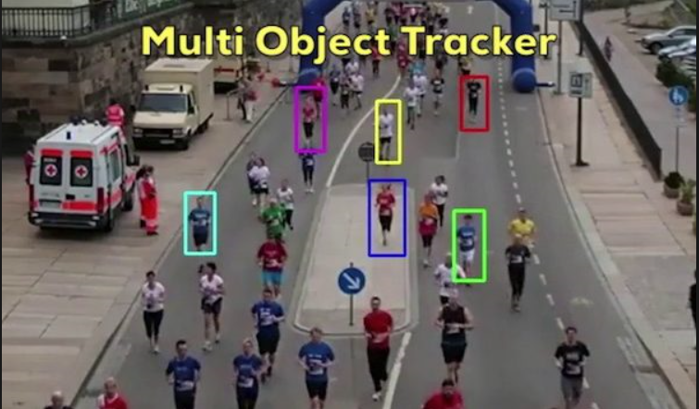
Data Fsuion
Online Multiple Objects Tracking System
Develop from single object tracking system
Locate a moving multiple objects over time in a video stream
Robust system against various challenges

Slide 5
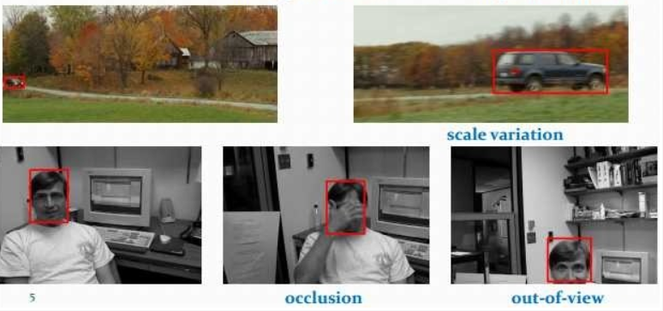
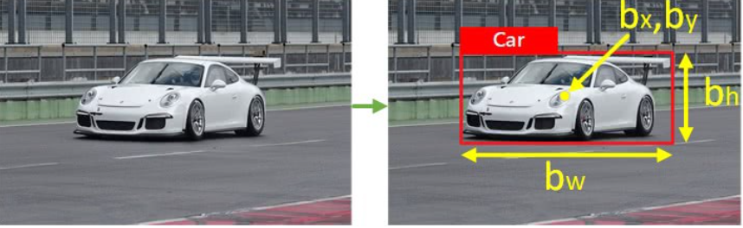
Data Fsuion
Online Multiple Objects Tracking System
Identify objects
Shown in bounding box
Represent by bounding box coordinate
(x,y,w,h)
Challenges:
Scale variation
Defomation
Occlusion
......
https://medium.com/@manivannan_data/object-tracking-referenced-with-the-previous-frame-using-euclidean-distance-49118730051a
https://www.cnblogs.com/jesse123/p/7126356.html

Slide 6
Data Fsuion
Online Multiple Objects Tracking System
Distinguish between multiple objects
Track initiation and termination
Set ID for every object
Challenges:
Similarity
Interaction between objects
….
https://www.youtube.com/watch?v=SLyABs_nJeg

Slide 7
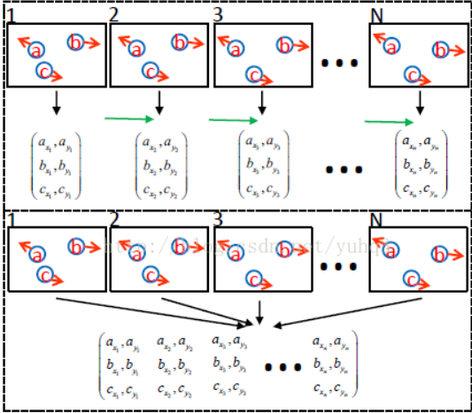
Data Fsuion
Online Multiple Objects Tracking System
Timely feedback system
Low delay
Online learning
Challenges:
Achieve the balance between
accuracy and efficiency
Lower robust against casual error
….
https://arxiv.org/abs/1409.7618

Slide 8
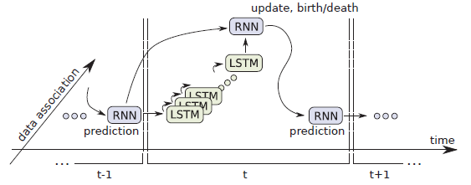
Data Fsuion
Online Multiple Objects Tracking System
Fours Steps:
Detect: Deformable Part Model Algorithm
Prediction: Recurrent Neural Network
Data Assignment: LSTM
Update: Recurrent Neural Network

Slide 9
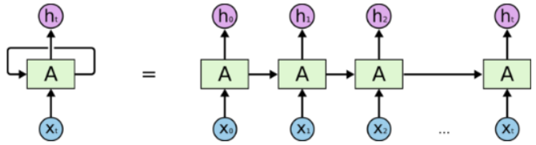
Data Fsuion
RNN
Combine of input layer, output layer, hidden layer
Learnable parameter: Hidden system state
Have memory, suitable for handling time series data
https://medium.com/explore-artificial-intelligence/an-introduction-to-recurrent-neural-networks-72c97bf0912

Slide 10
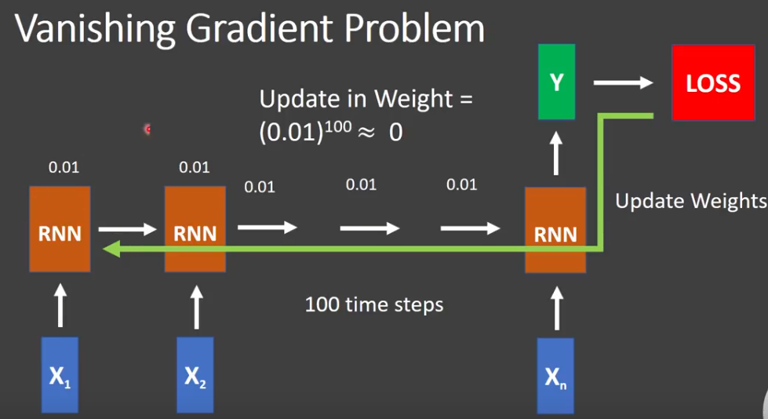
Data Fsuion
RNN
Hard to store long term memory due to ”Gradient Vanishing”(Sometime “Gradient Exploding”)
Unsuitable for data association Task
https://www.youtube.com/watch?v=S0XFd0VMFss

Slide 11
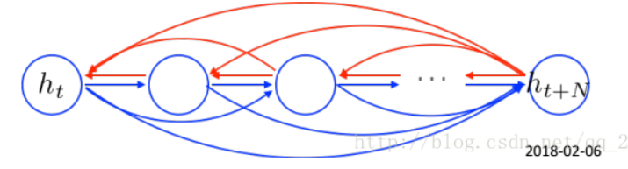
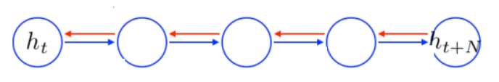
Data Fsuion
LSTM
Develop from RNN
Add forget gate and remember gate
Access remote history information without loss
Used to build the data assignment
RNN
LSTM
https://blog.csdn.net/qq_28031525/article/details/79423450

Slide 12
Outline
Introduction
Online Multiple Objects Tracking System
RNN and LSTM
MOT System
Object Detect
State Predicted
Data Association
State Update
Conclusion
Performance
Promotion

Slide 13
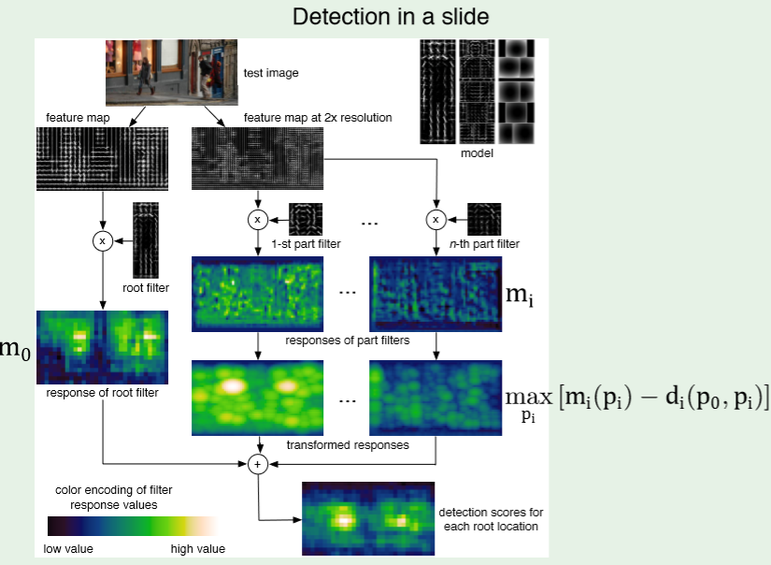
Data Fsuion
Object Detect
Deformable Parts Model
Develop from HOG (Histograms of Oriented Gradients)
Basic Idea:
Create suitable feature kernel according to deep learning
Apply convolutional operation and get global response
Apply softmax function and get bounding box with most high possibility
Output bounding box coordinate
http://vision.stanford.edu/teaching/cs231b_spring1213/slides/dpm-slides-ross-girshick.pdf

Slide 14
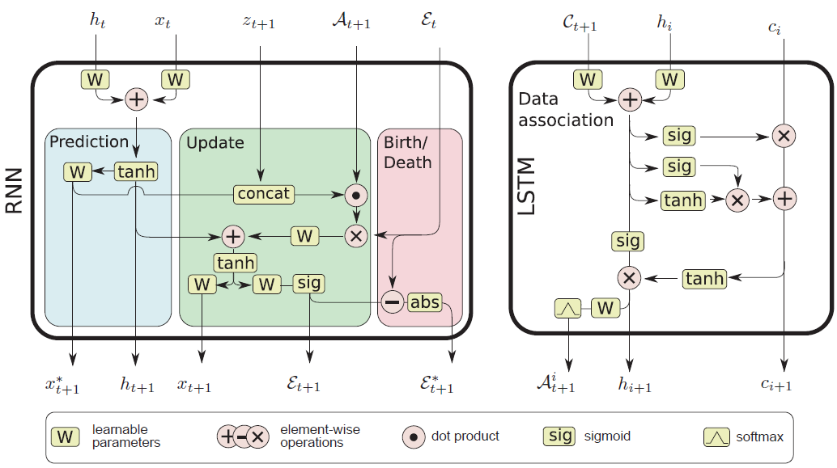
Data Fsuion
Topological graph

Slide 15

Data Fsuion
State Predicted
$X^{t}$ ∈ $R^{N∗D} represent$vector containing the states for all targets at one time instance
N is the number of interacting targets that are tracked simultaneously in one frame
D = 4, since we use bounding box coordinate (x,y,w,h)
$h^{i} and C_{t}$ represent hidden state of association model

Slide 16
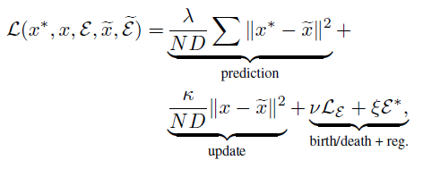
Data Fsuion
State Predicted
Used given loss function and backpropagation algorithm to update learnable parameter
Used labeled data to learn a dynamic model for predicting target motion

Slide 17

Data Fsuion
Data Association
$c^{t+1}$ ∈ $R^{N∗M} represent$where $c^{ij} ={|\left|x^{i} − z^{j}\right||}^{2}$is the Euclidean distance between the predicted state of target i and measurement state j
M is the maximum number of detections per frame.
$A_{t+1}^{i}$ ∈ ${\text{[0}\text{, }\text{1]}}^{N∗(M+1)}$ represents assignment probability matrix
$h^{t}$ and $c^{i}$ represent hidden state of predicted model

Slide 18
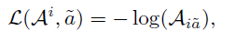
Data Fsuion
Data Association
Used given loss function and backpropagation algorithm to update learnable parameter
Straight-forward to extend the feature vector to incorporate appearance or any other similarity information
vector of probabilities for one target and all available measurements, applying a softmax layer with normalisation to the predicted values

Slide 19
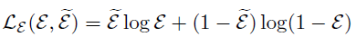

Data Fsuion
Data Update
$z^{t+1}$ ∈ $R^{M∗D} represent \text{the} \text{vector} \text{of} \text{all} \text{measurements} \text{in} \text{one} \text{frame}\text{, }\text{where} \text{M} \text{is} \text{maximum} \text{number} \text{of} \text{detections} \text{per} \text{frame}$
$ε$ ∈ ${\text{[0}\text{, }\text{1]}}^{N}$ is an indicator vector that represents the existence probability of a target
$Set \text{threshold} value to ε \left(0.6\right).when ε<0.6, we can terminate tracking this object$
$x^{t+1}$ ∈ $R^{N∗D} represents$ all updated states

Slide 20
Outline
Introduction
Online Multiple Objects Tracking System
RNN and LSTM
MOT System
Object Detect
State Predicted
Data Association
State Update
Conclusion
Performance
Promotion

Slide 21
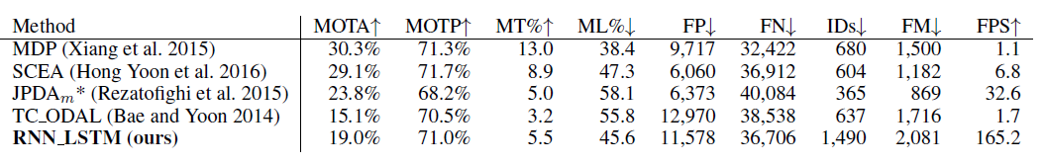
Data Fsuion
Performance
Not quite reach the top accuracy
Is two orders of magnitude faster

Slide 22
Data Fsuion
Advantage
Use temporal data
Do not need prior knowledge
Timely system

Slide 23
Data Fsuion
Promotion
Long training period
Really bad explainability
Achieve the balance between online and offline method

Slide 24

Question time
Source:familybusinessunited.com

Slide 25
Reference
[1] P. K. Varshney . Multisensor data fusion. https://arxiv.org/pdf/1604.03635.pdf
[2] Vibhor nigam .Understanding Neural Networks. From neuron to RNN, CNN, and Deep Learning
[3] Josua Krause. Using Visual Analytics to Interpret Predictive Machine Learning Models
[4] A Milan.Online Multi-Target Tracking Using Recurrent Neural Networks

